Slide 1
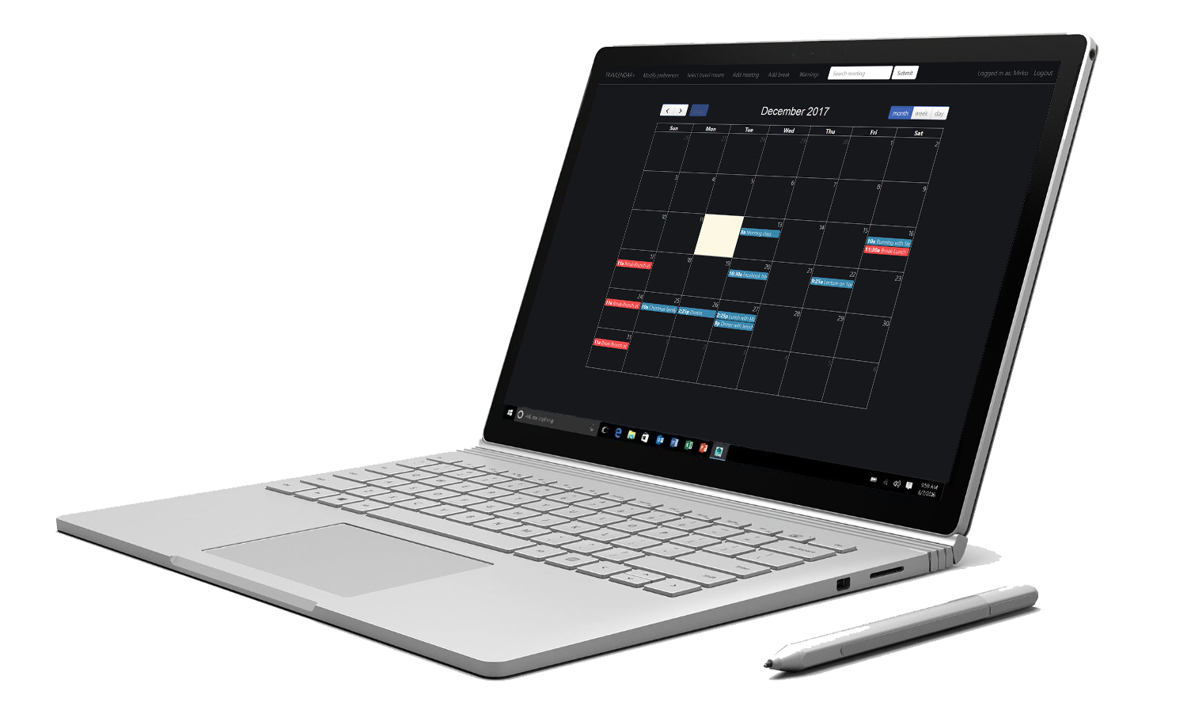

Software Engineering II Travlendar+
Matteo Marziali – Mirko Mantovani
20/02/18

Slide 2
The world and the machine

Slide 3
What makes our project unique?
Conflict management: The conflict management is on the user, who can decide whether to ignore the overlap or to solve it by rescheduling appointments.
Why:
User before Travlendar+
No need to delete meetings in the system in case of cancelled appointments
Negative aspects:
Additional complexity
Possible side effects

Slide 4
Conflict management sequence diagram

Slide 5
Minor peculiarities
Starting point Issue: Each displayed route is computed between a (variable) starting point chosen by the user when he/she wants to see the route and the appointment location.
Weekly breaks: The system allows to set the breaks weekly, that is the break is automatically scheduled at the same day and the same time for every following week.
Notifications to meeting participants: Meeting participants are notified via e-mail in case of deletion.
Reminders: the user can set up a reminder and he will be notified before the meeting starts.

Slide 6
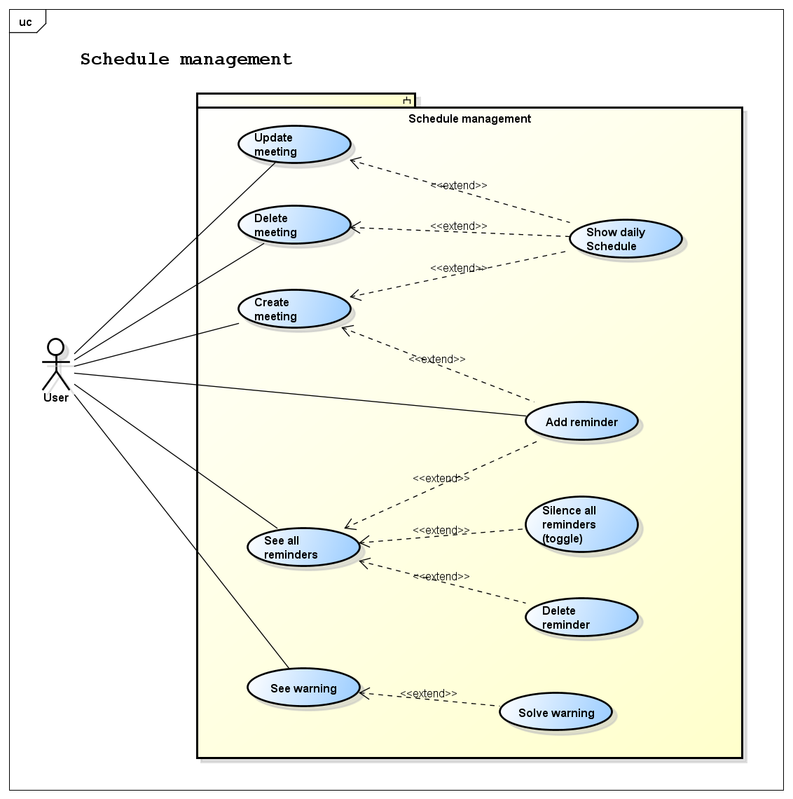
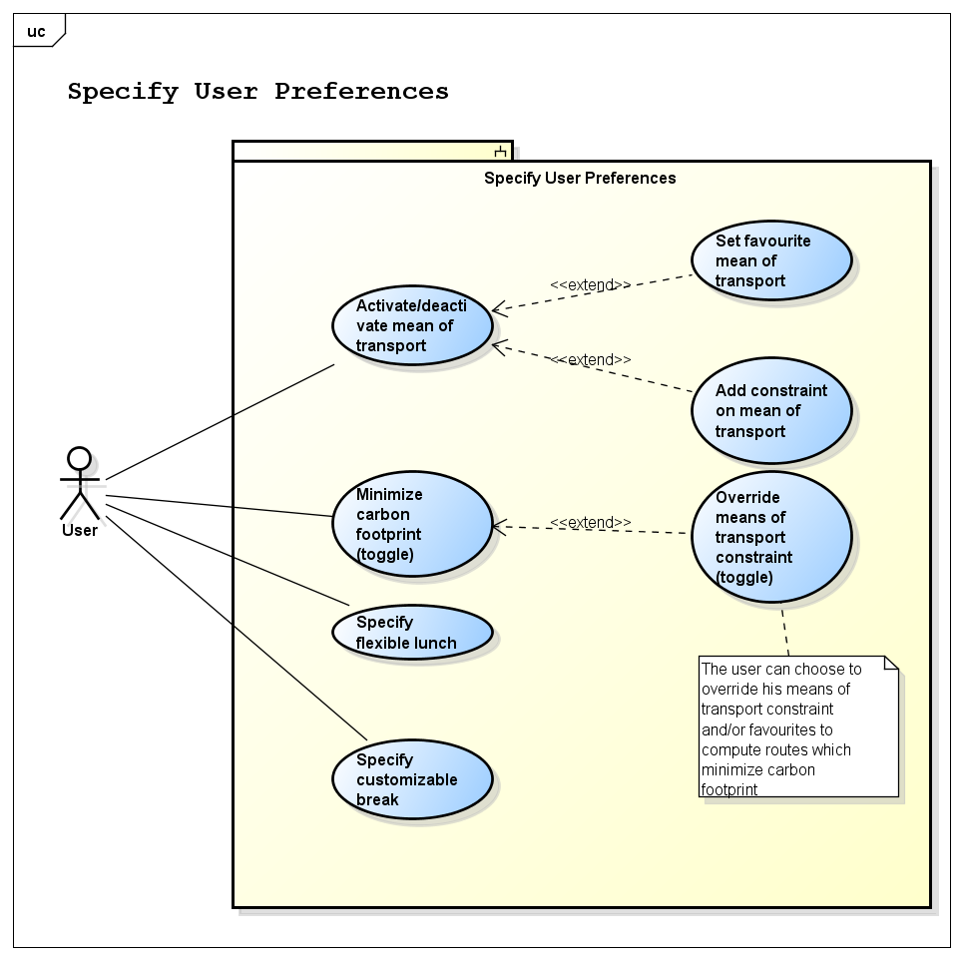
Use Cases

Slide 7
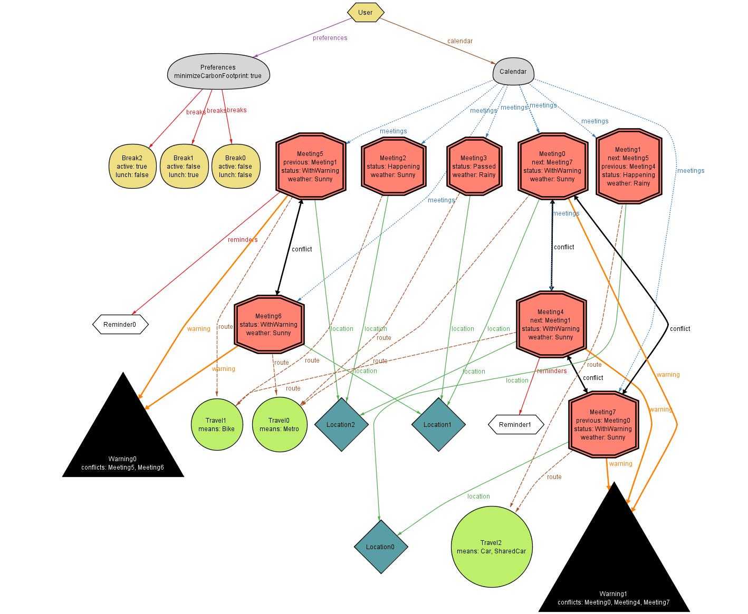
Alloy modelling
Generated World 1
Single user reality to better understand the usage of the application within the user context

Slide 8
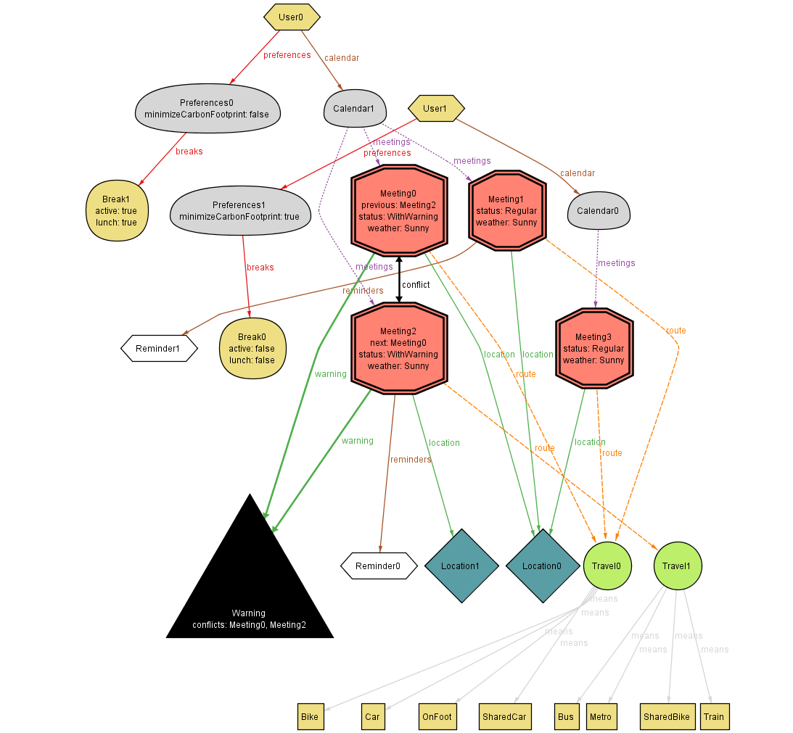
Alloy modelling
Generated World 2
Multi-client perspective of the application

Slide 9
High-level architecture
Client tier: input/output interactions with the User
Web tier: receives requests from client and sends a response after the data is processed by the business logic and ready to be sent back to the client
Business logic tier: receives data from the web tier, processes it, CRUD directives to the persistence tier
Persistence tier: stores and retrieves information from the database

Slide 10
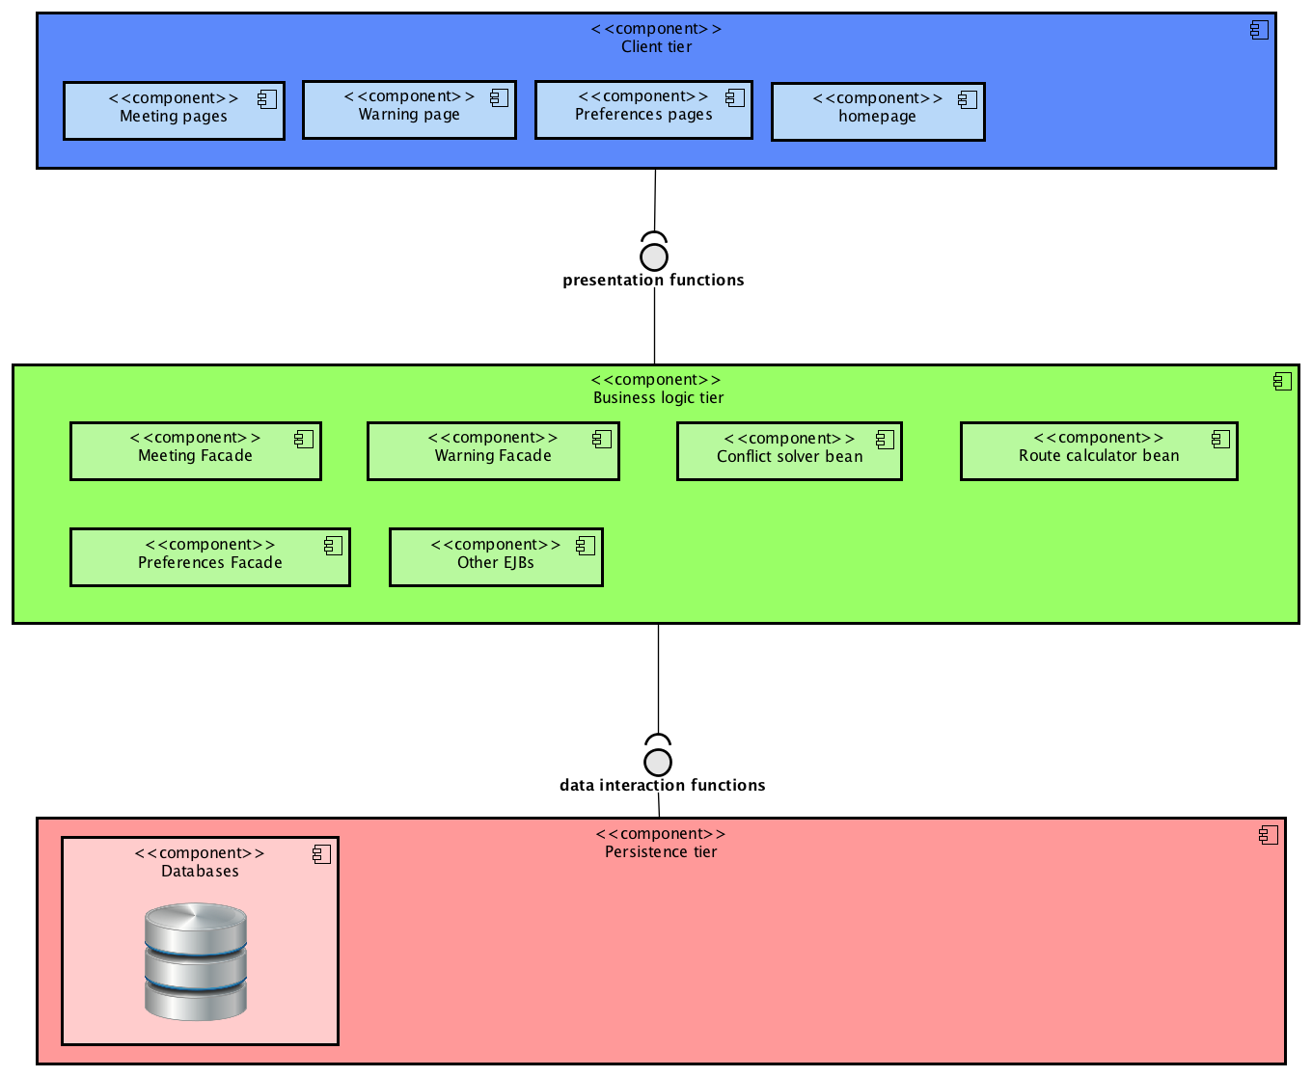
High-level Component Diagram

Slide 11
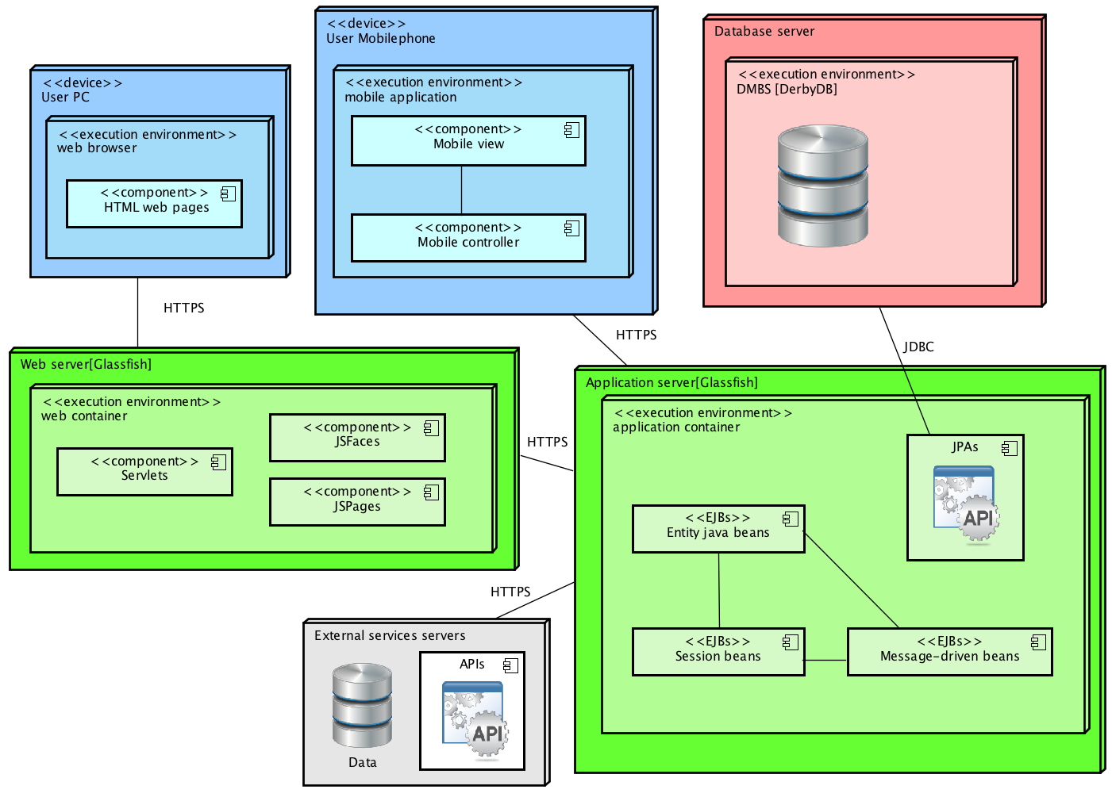
Deployment diagram

Slide 12
web application vs. mobile application?
Web application:
Cross-platform
Reliability
Lightweight
Mobile application:
Compatibility problems
less reliable
Less related with device performances

Slide 13
Implemented functionalities
[F1] Signup and Login
[F2] Meeting creation
[F3] Preferences set up + avoid tolls, highways
[F4] Warnings management
[F5] Route generation
[F8] Update/Delete meeting
[F9] Add/Delete break
[F10] Search meeting

Slide 14
Source code structure – Back end
Entities: Java entity classes mapped to the database through JPA
Servlets: Handling http get/post requests and responses. Used as access points to customized JSPs or to manipulate data and compute results using EJBs
Session Beans: Used to interact with the database and run concurrently onerous algorithms
Utils: Contains plain Java classes with mainly static methods used by servlets and beans

Slide 15
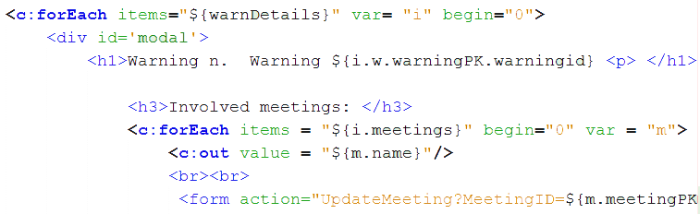
Source code structure – Front end
JSPs with no scriptlets
Dynamicity of html content mainly achieved by using Expression Language and JSTL
CSS, Javascript

Slide 16
Testing

Slide 17
Testing on conflict management functionalities
Most complex coding part
Core of the application

